Slide 1
Paperless Restaurant App
Coursework 2
Group 3
Connor Partington
David Beattie
Cody Lawson
Luke Mather
Scott Davies

Slide 2
Technologies Used
Front-end Framework / Presentation Layer – Bootstrap 4
Back-end Framework / Application Layer – Node.js, Express, Various Modules
Database Management System / Data Layer – MongoDB
Middleware – jQuery, Ajax, JavaScript

Slide 3
Front-end Framework
Bootstrap 4
This was chosen over Angular.js based on previous experience. Angular would have been an extra learning curve and slowed down development of the application, while Bootstrap has been used multiple times and is well known to us.
Open Source, Easy to use, very common components (CSS. HTML, JavaScript), Fast and sleek we development.

Slide 4
Back-end Framework
Node.js, Express

Slide 5
Database Management System
MongoDB
This was quick and easy to learn with a simple learning curve compared to previously working with MySQL.

Slide 6
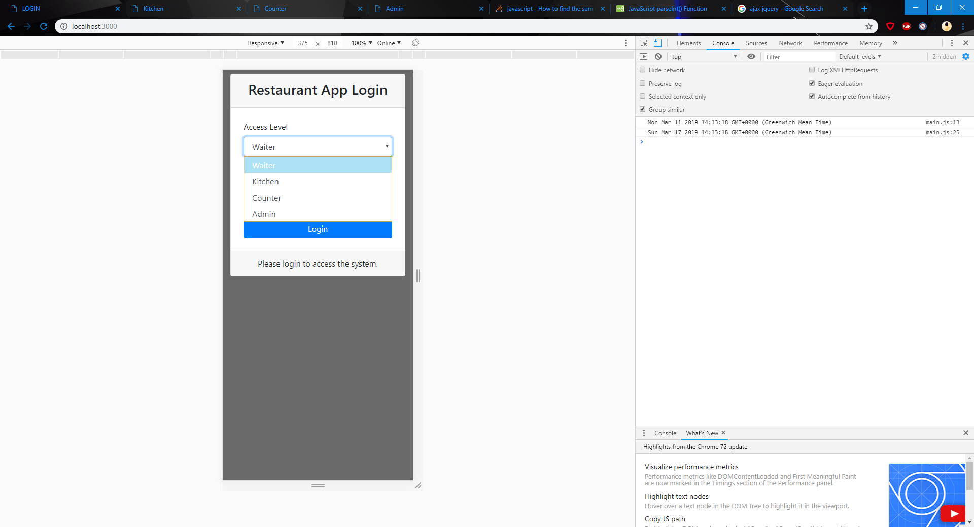
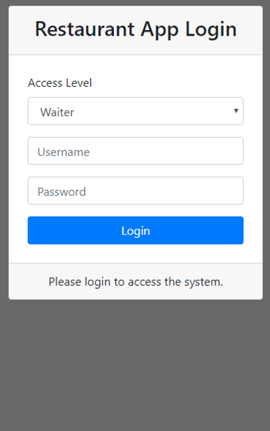
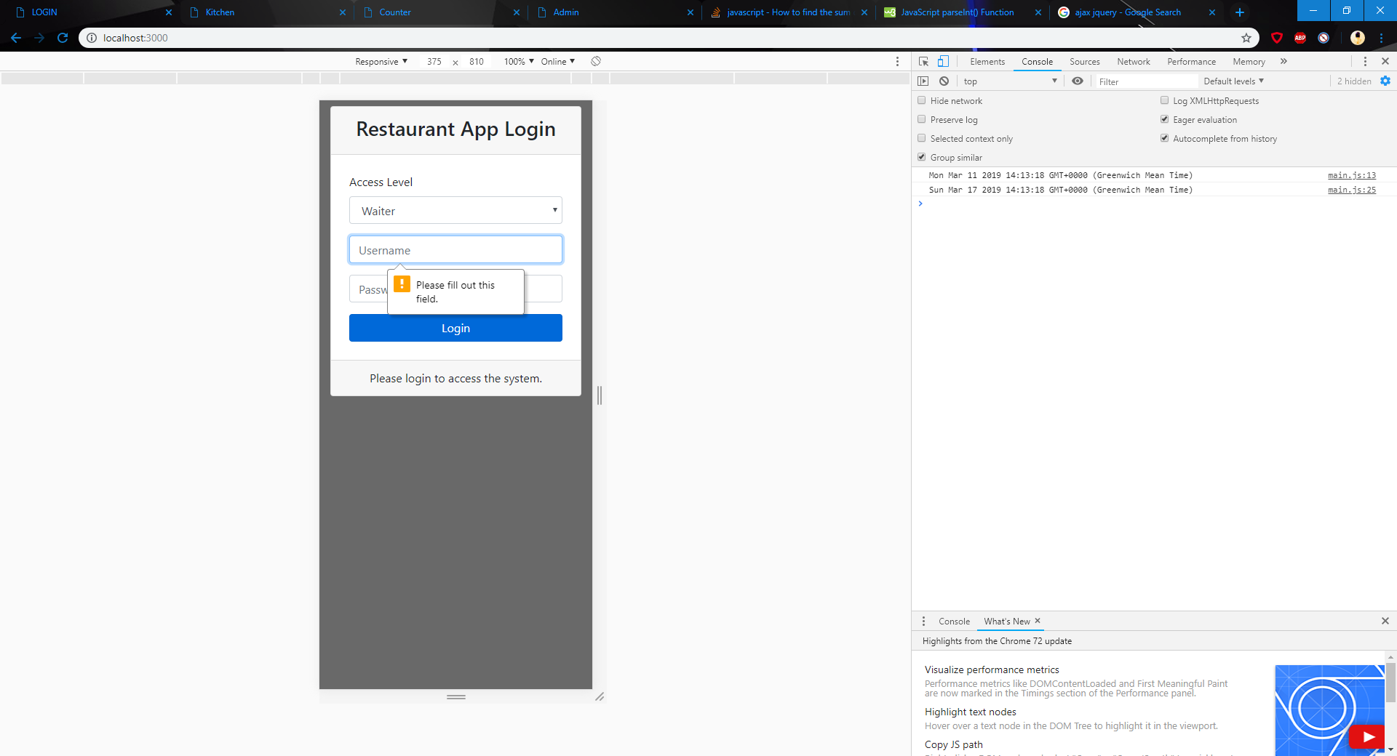
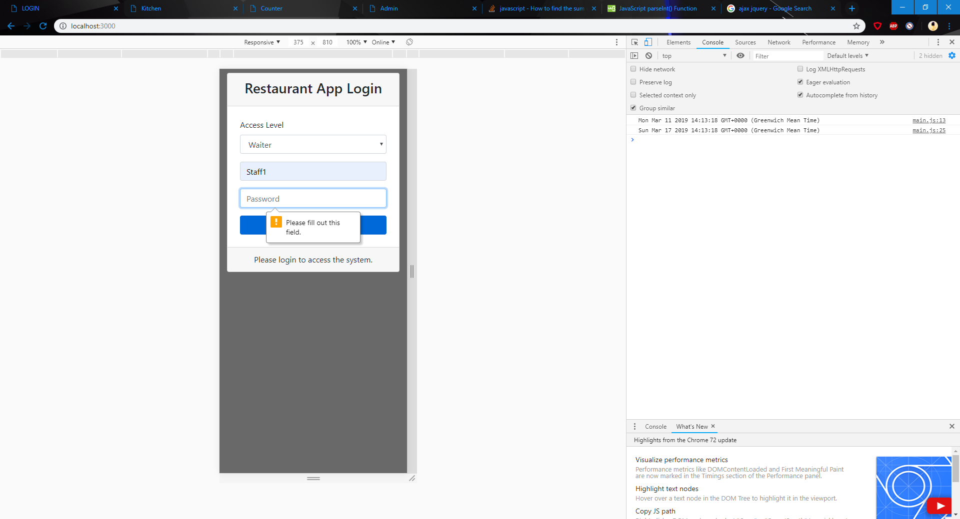

Login
Multiple Access Levels
Username + Password
Client-side validation
Sever-side validation
Fully Responsive

Slide 7
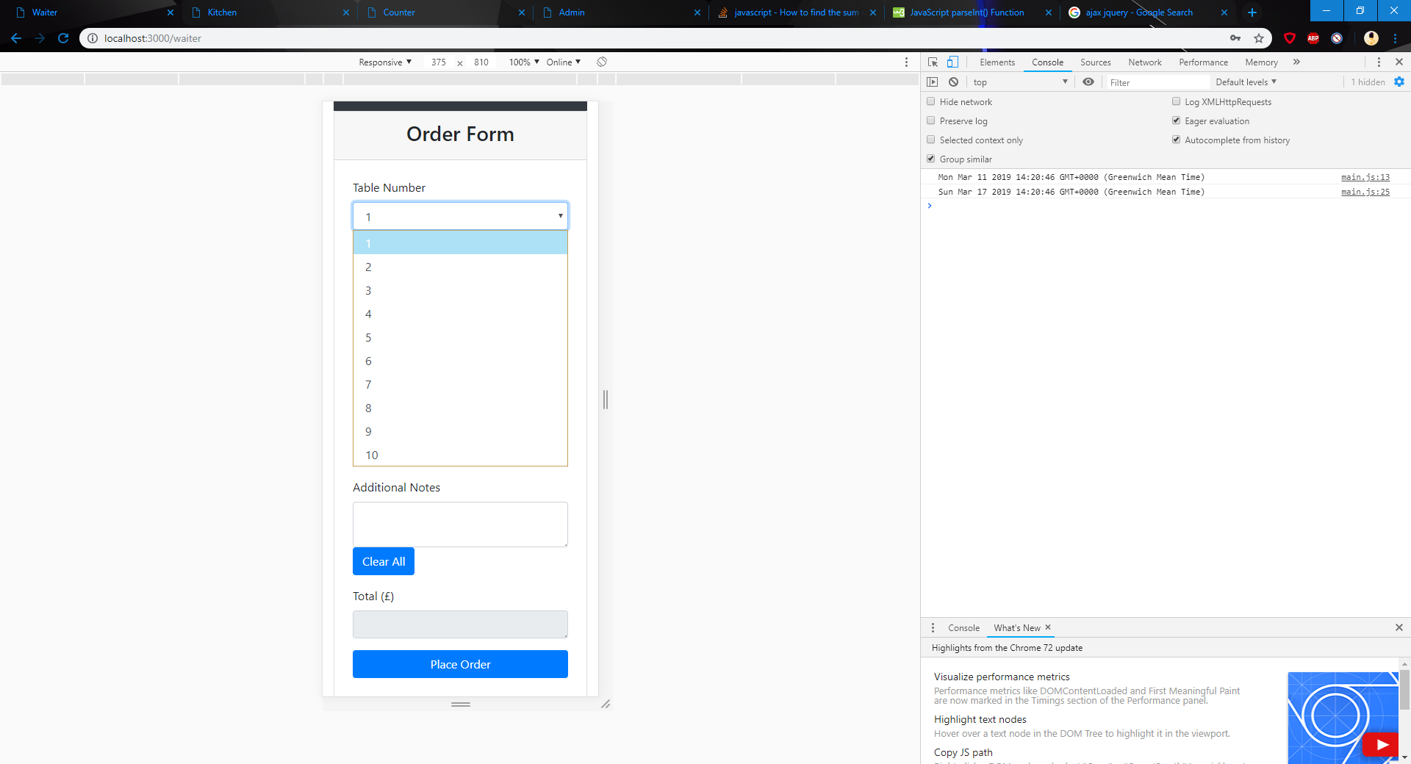
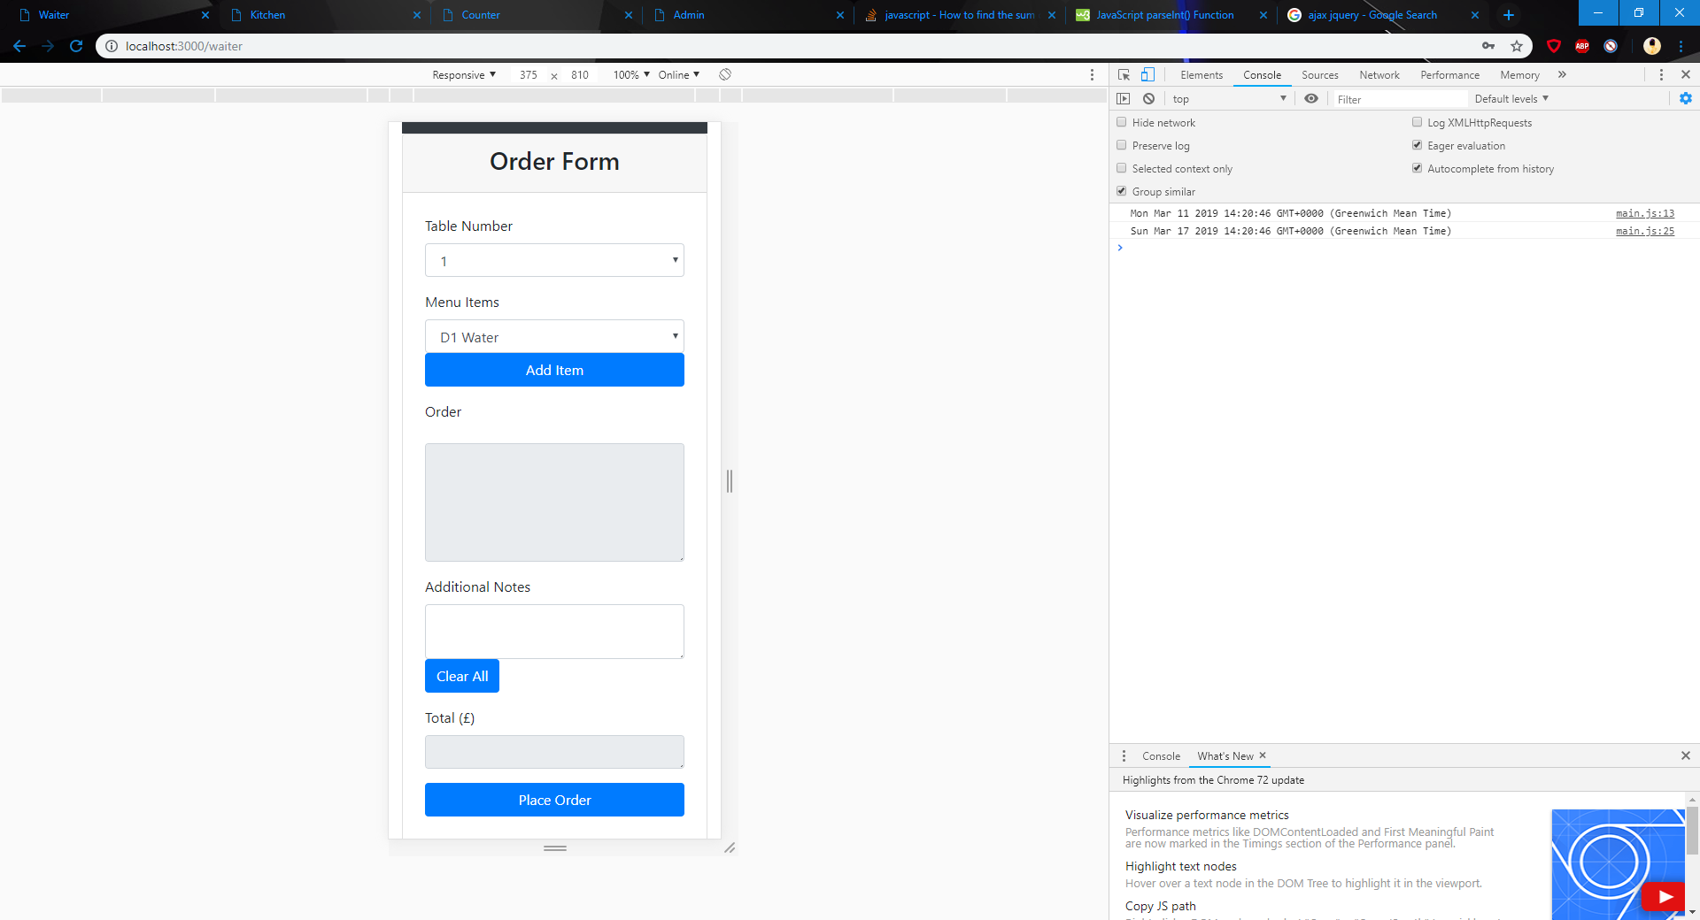
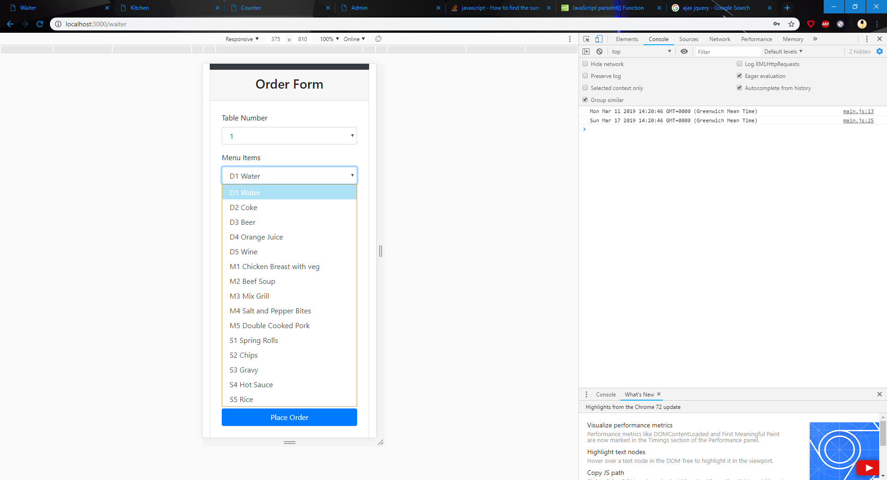
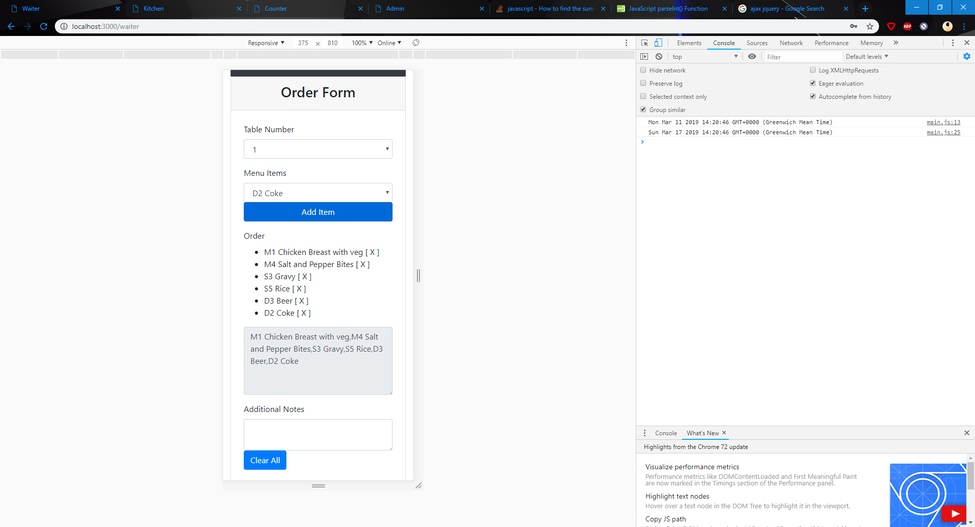
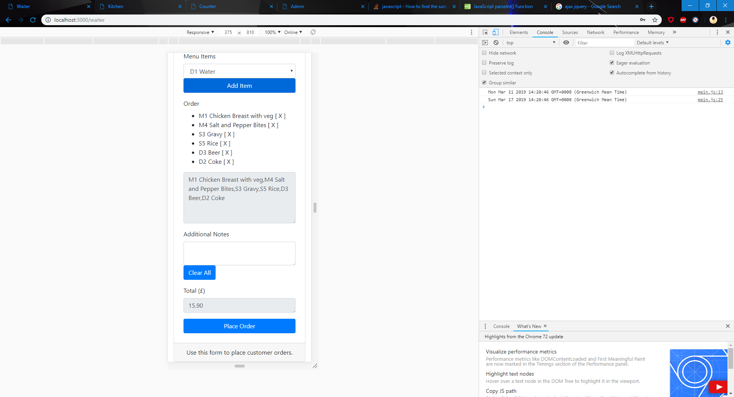
Waiter View
Table Selection
Menu Item Selection
Dynamically updated menu
Asynchronous
Ability to delete items
Order Preview
Dynamically updated total cost

Slide 8
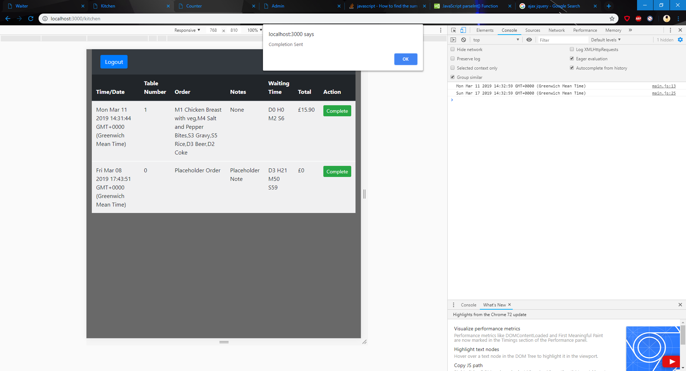
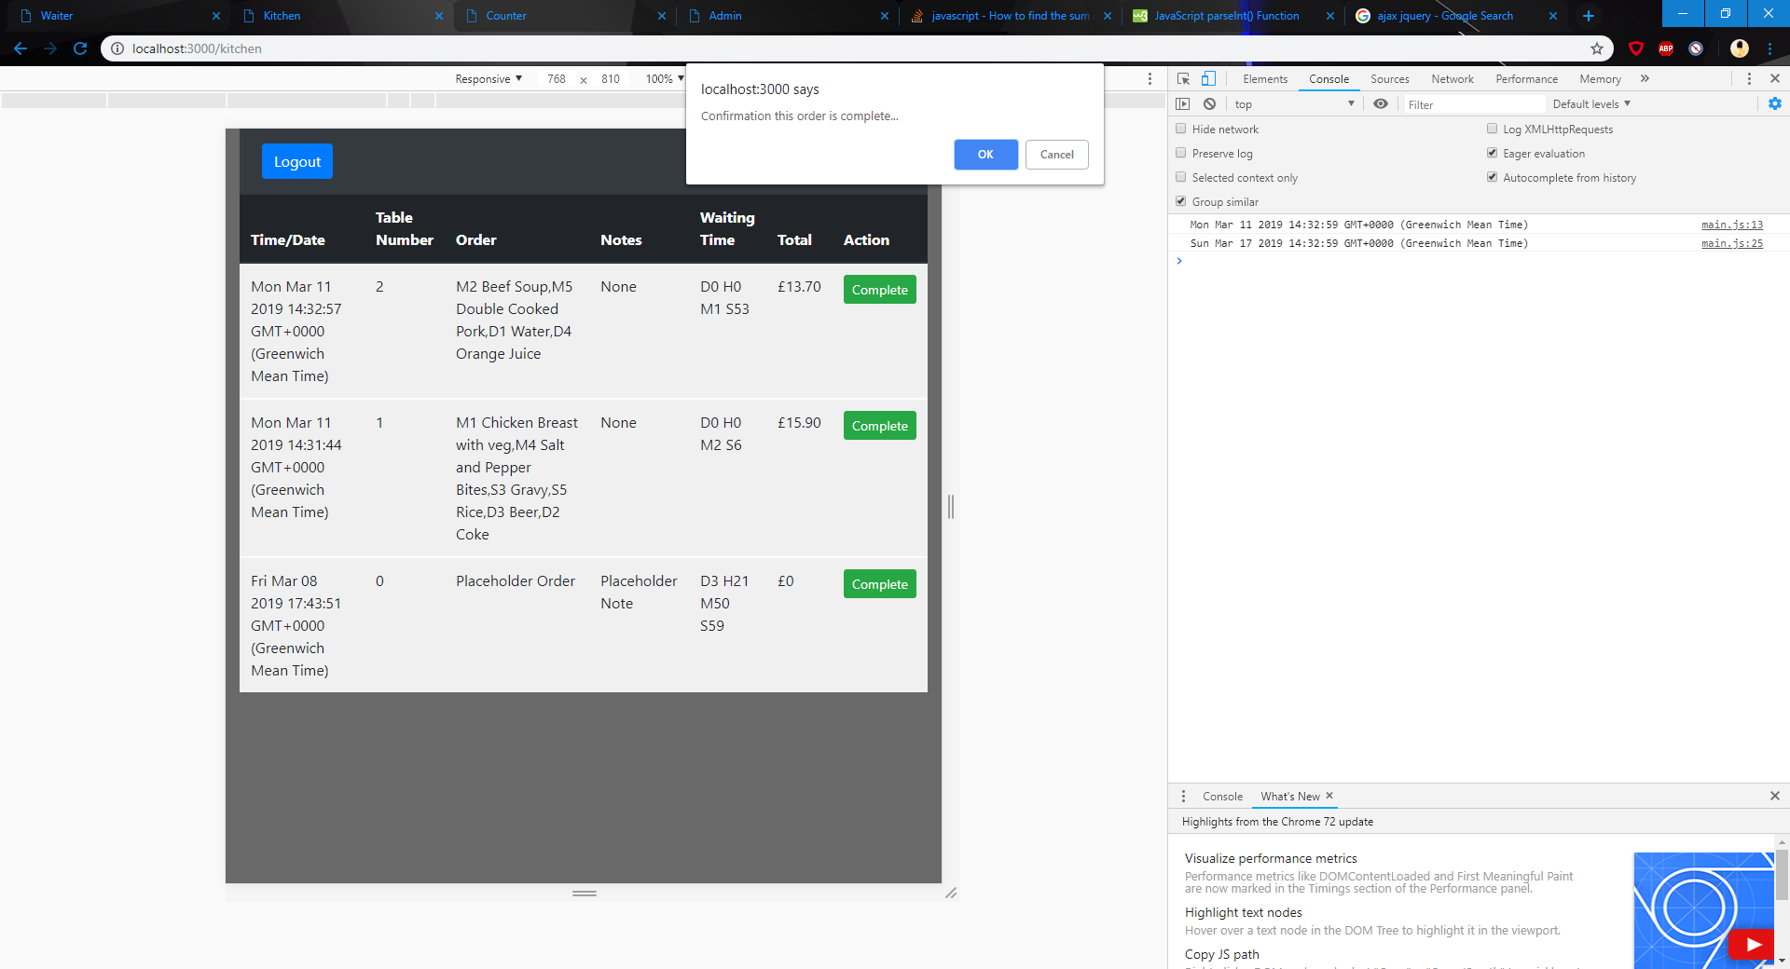
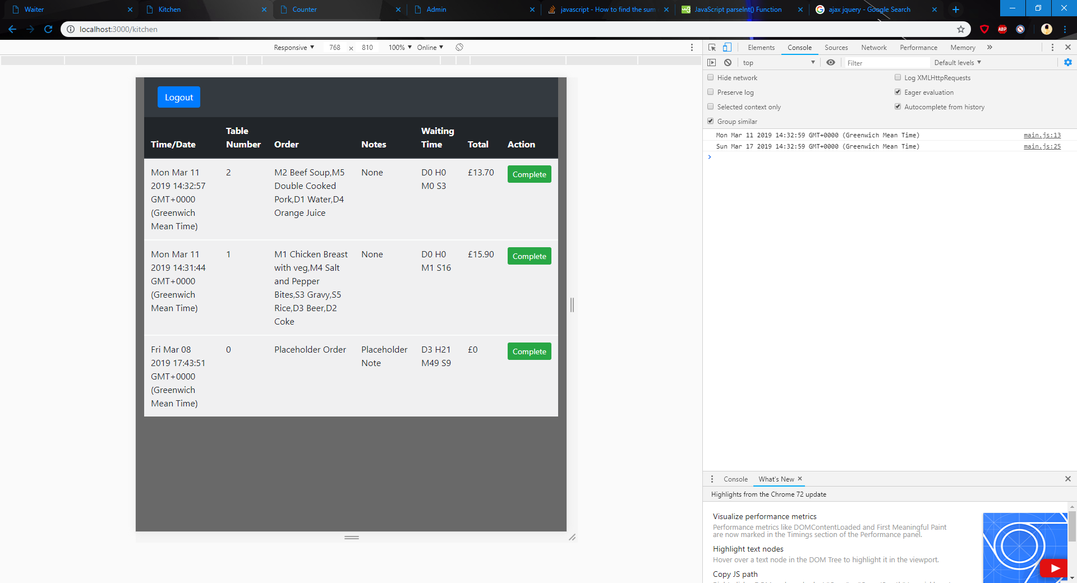
Kitchen View
Simple and clean layout
Confirmation messages
Dynamically updated table and Waiting Time
Partially Responsive

Slide 9
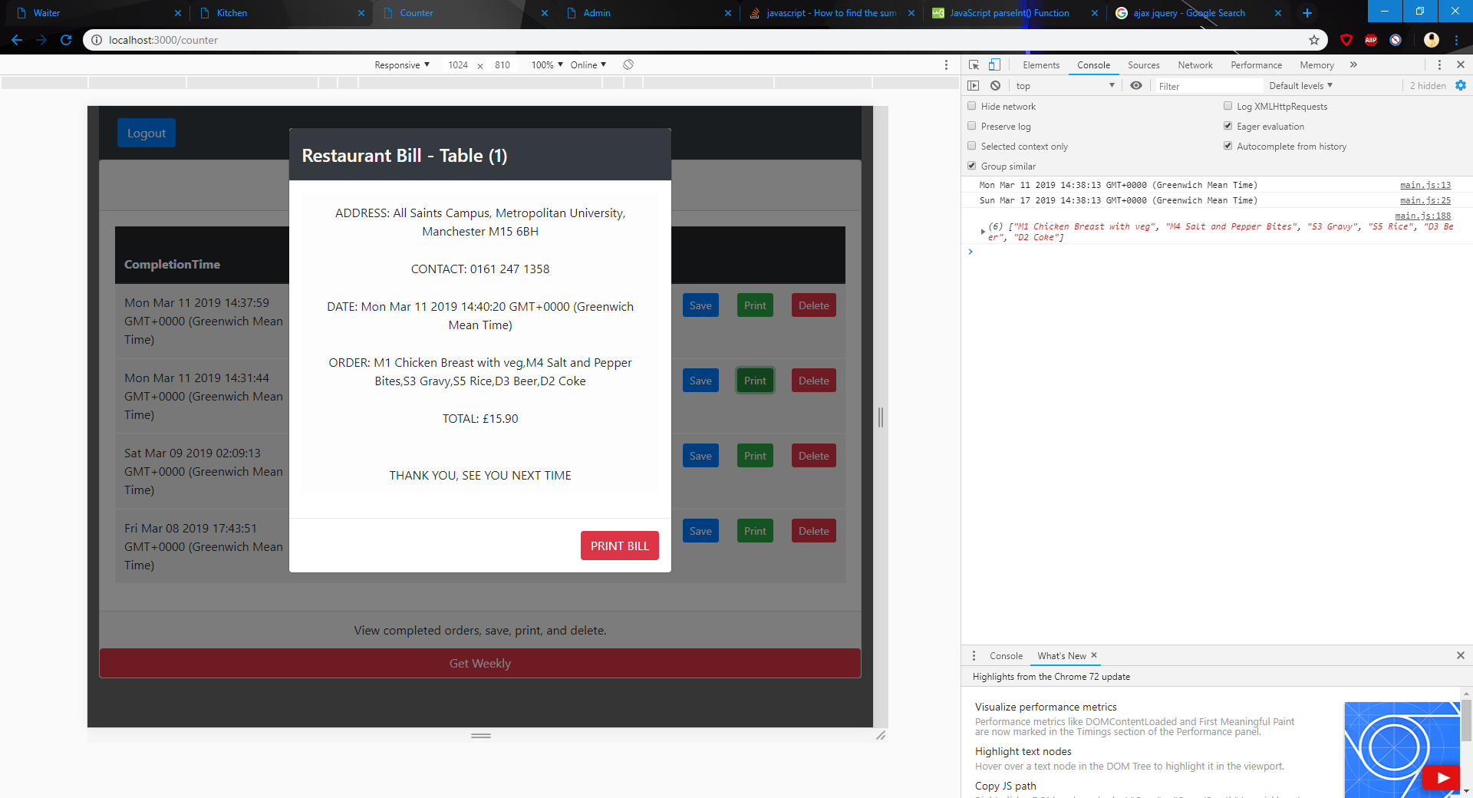
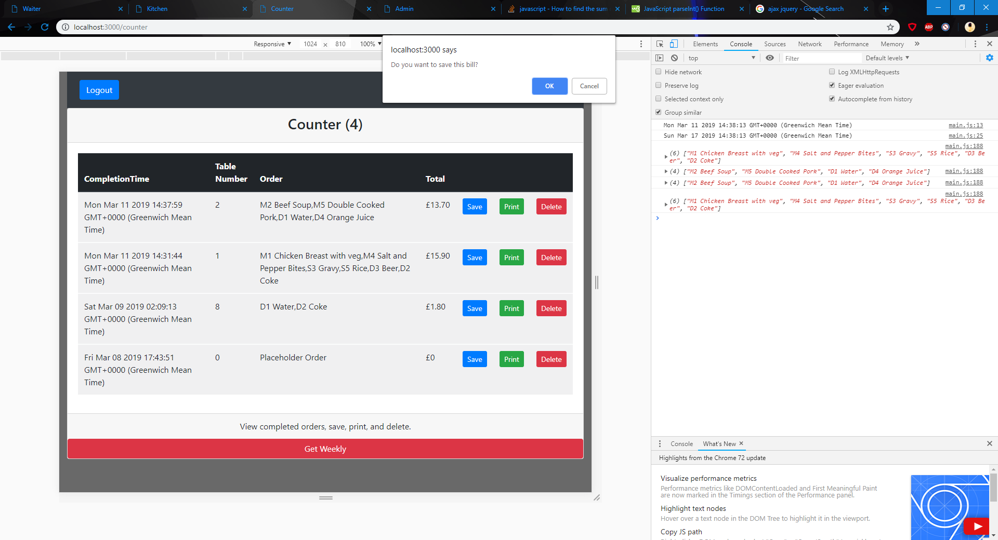

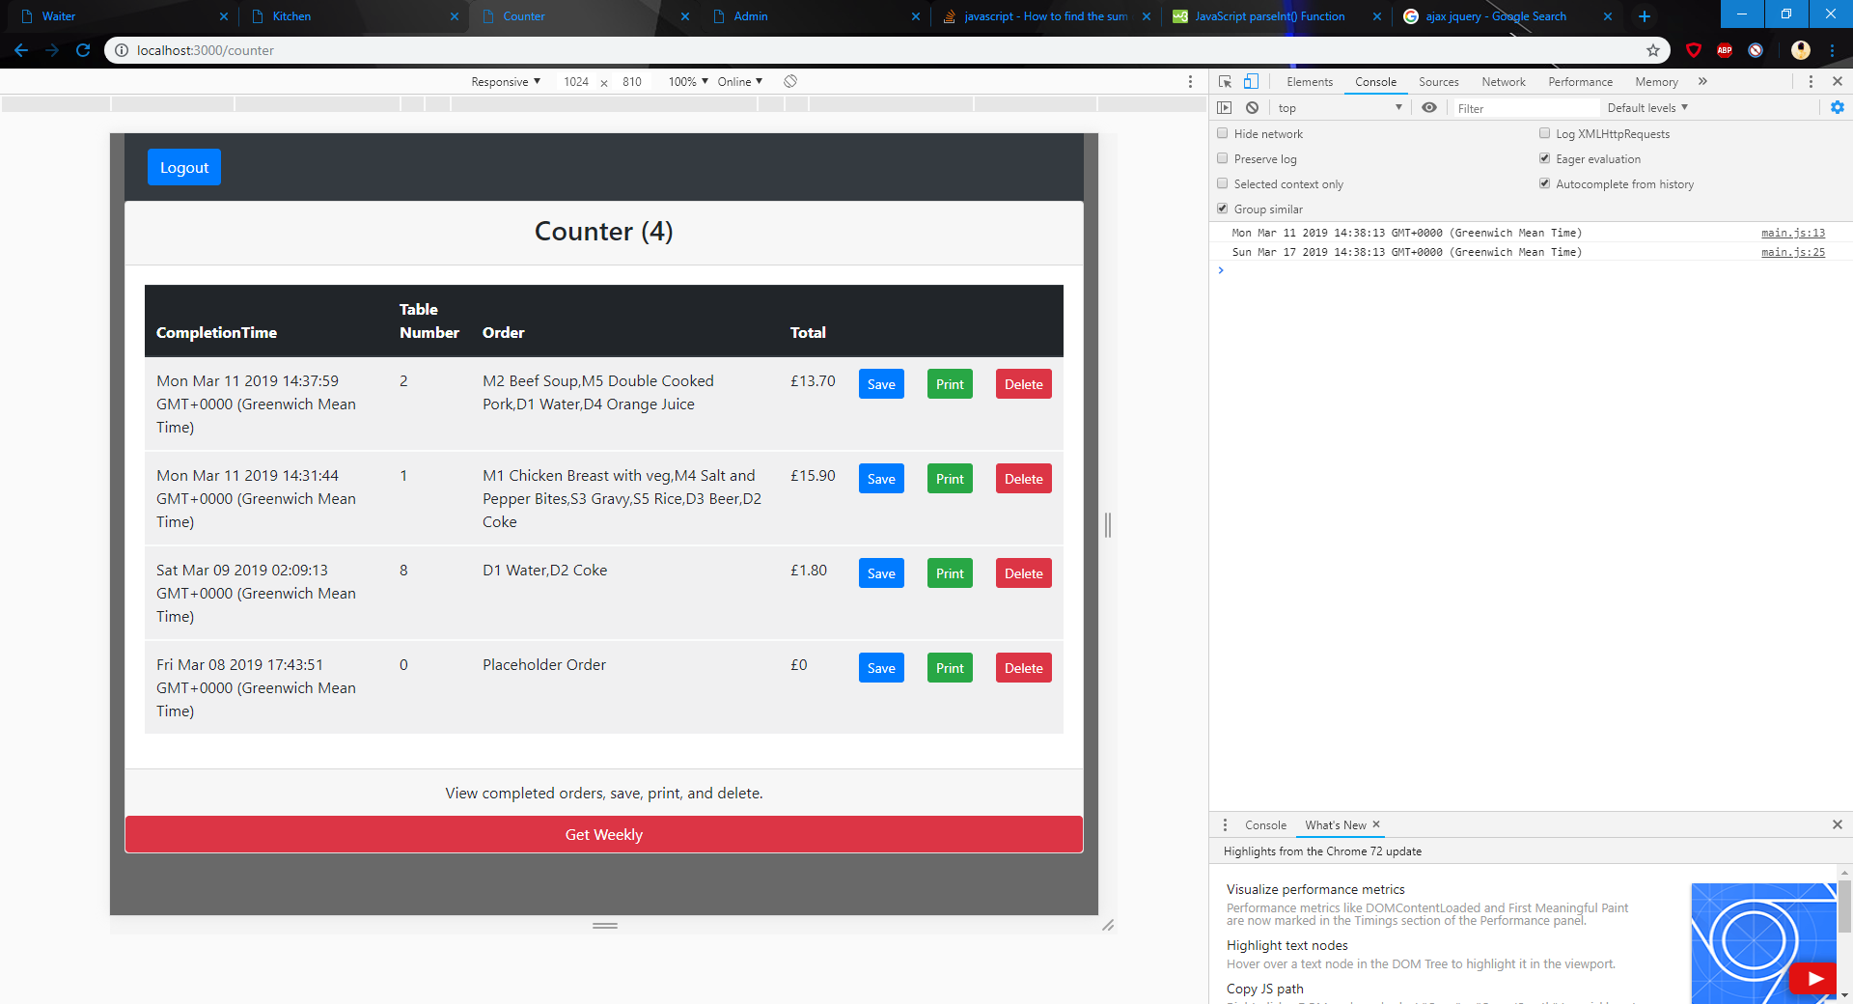
Counter View
Ability to save, print, and delete completed orders
Print displays preview and then another tab for printing as .pdf file
Dynamically updated
Confirmation messages

Slide 10
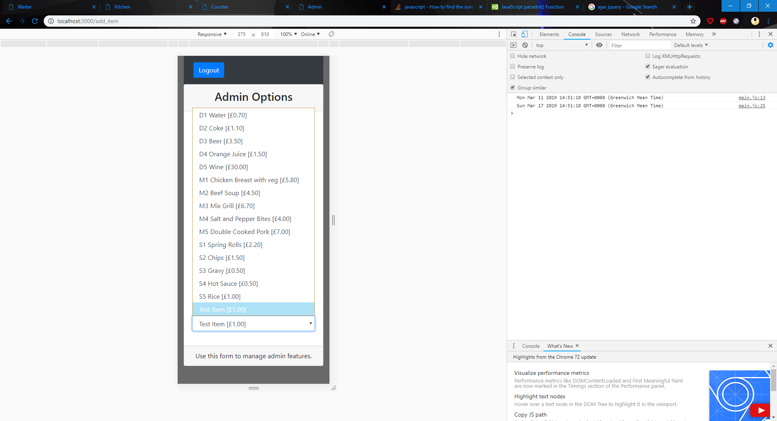
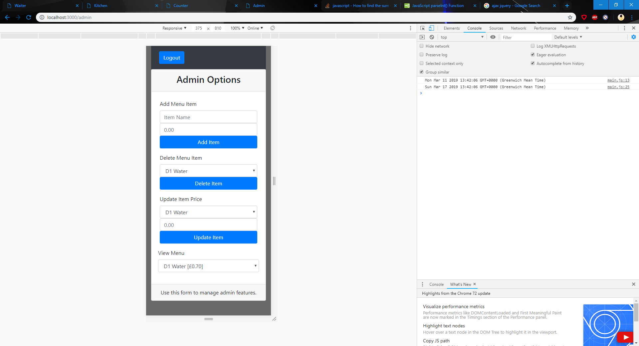

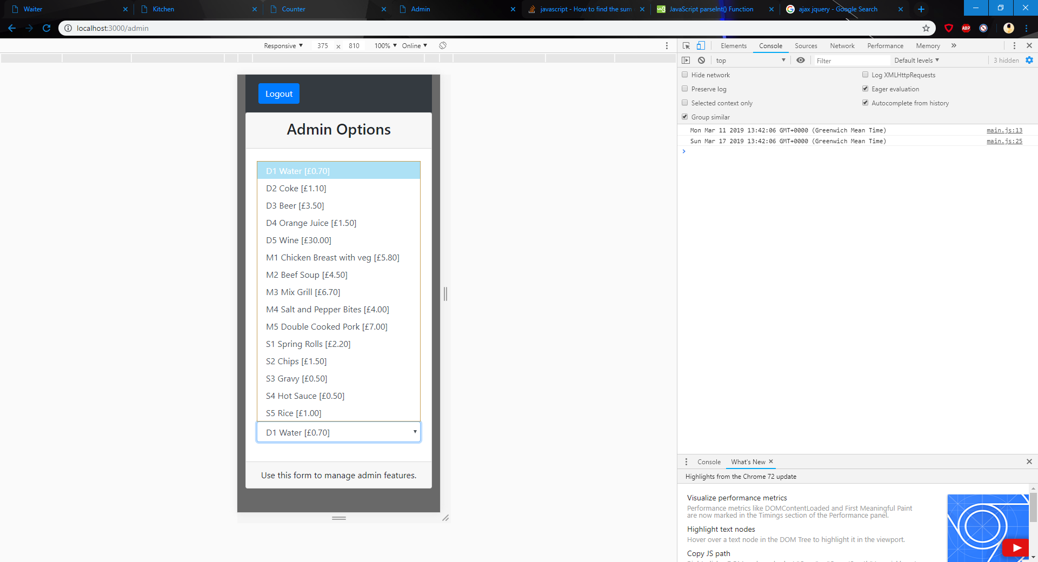
Admin View
Ability to add, delete, and update menu items
Dynamically updated
Full menu and prices can be viewed
Updates waiter view with changes

Slide 11
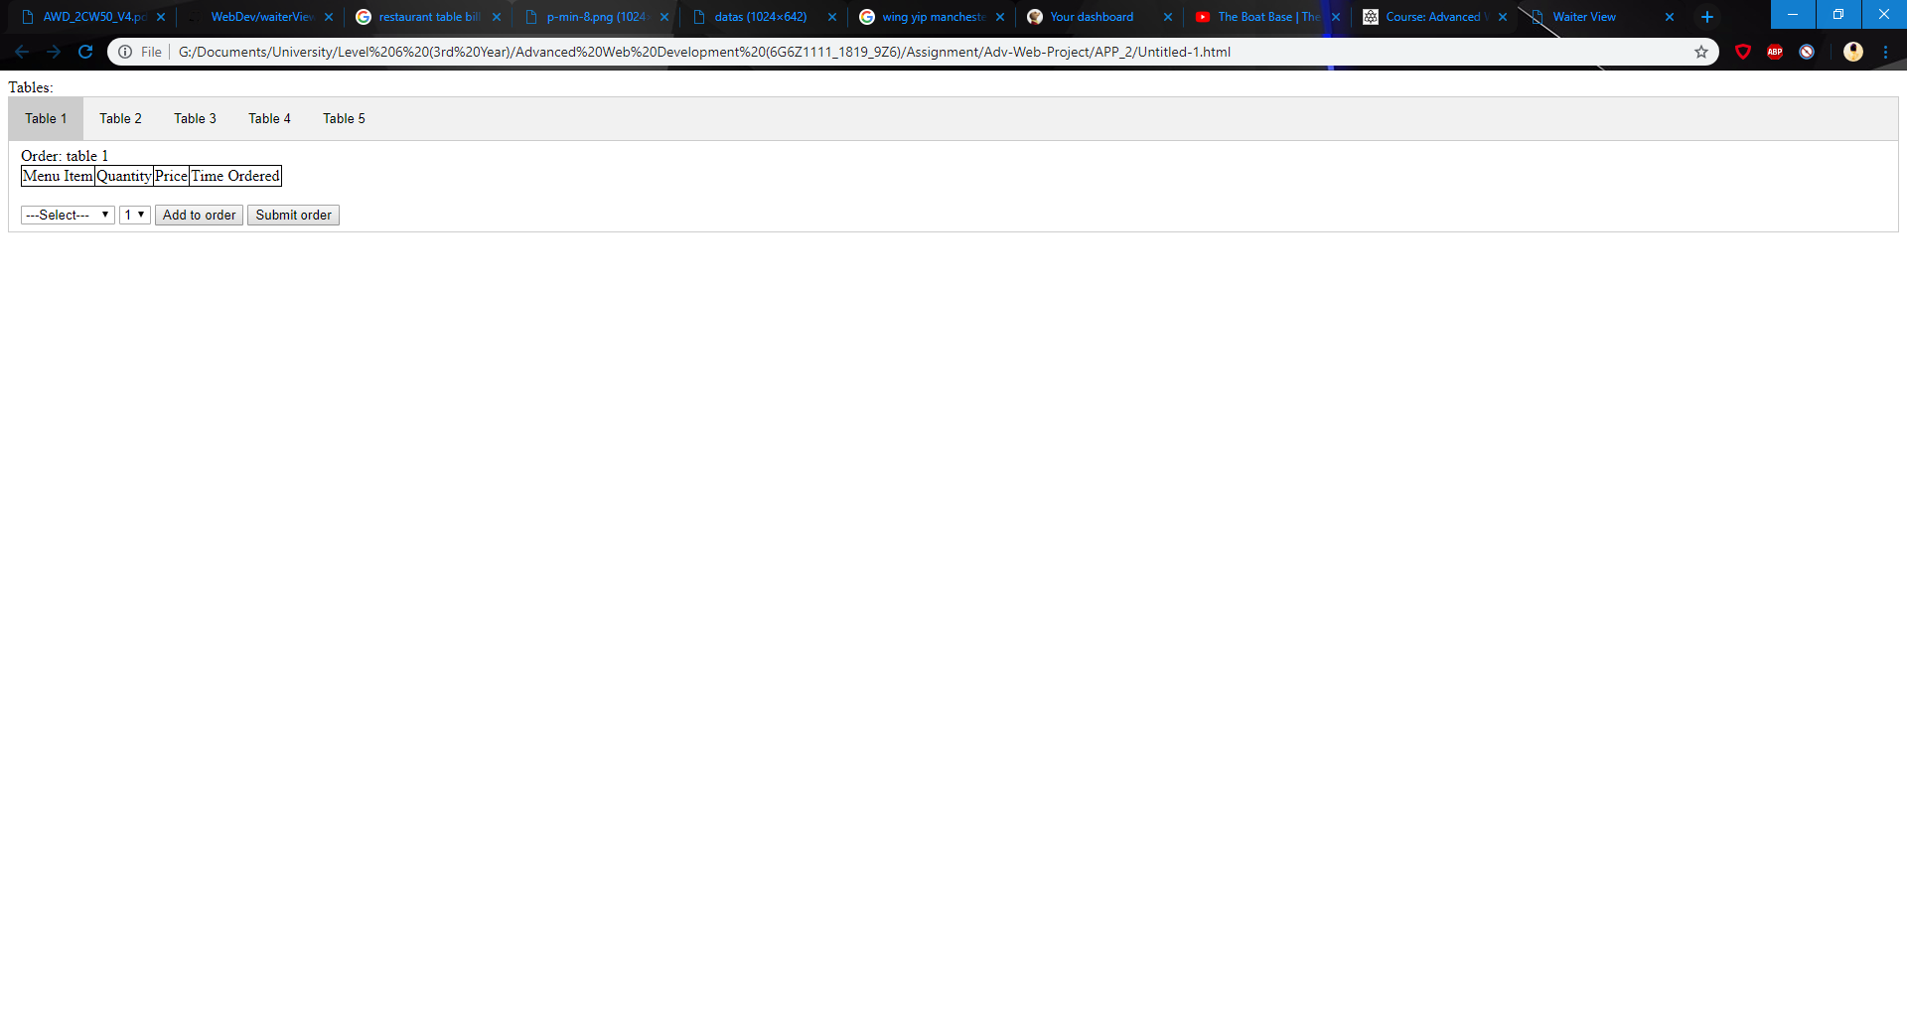
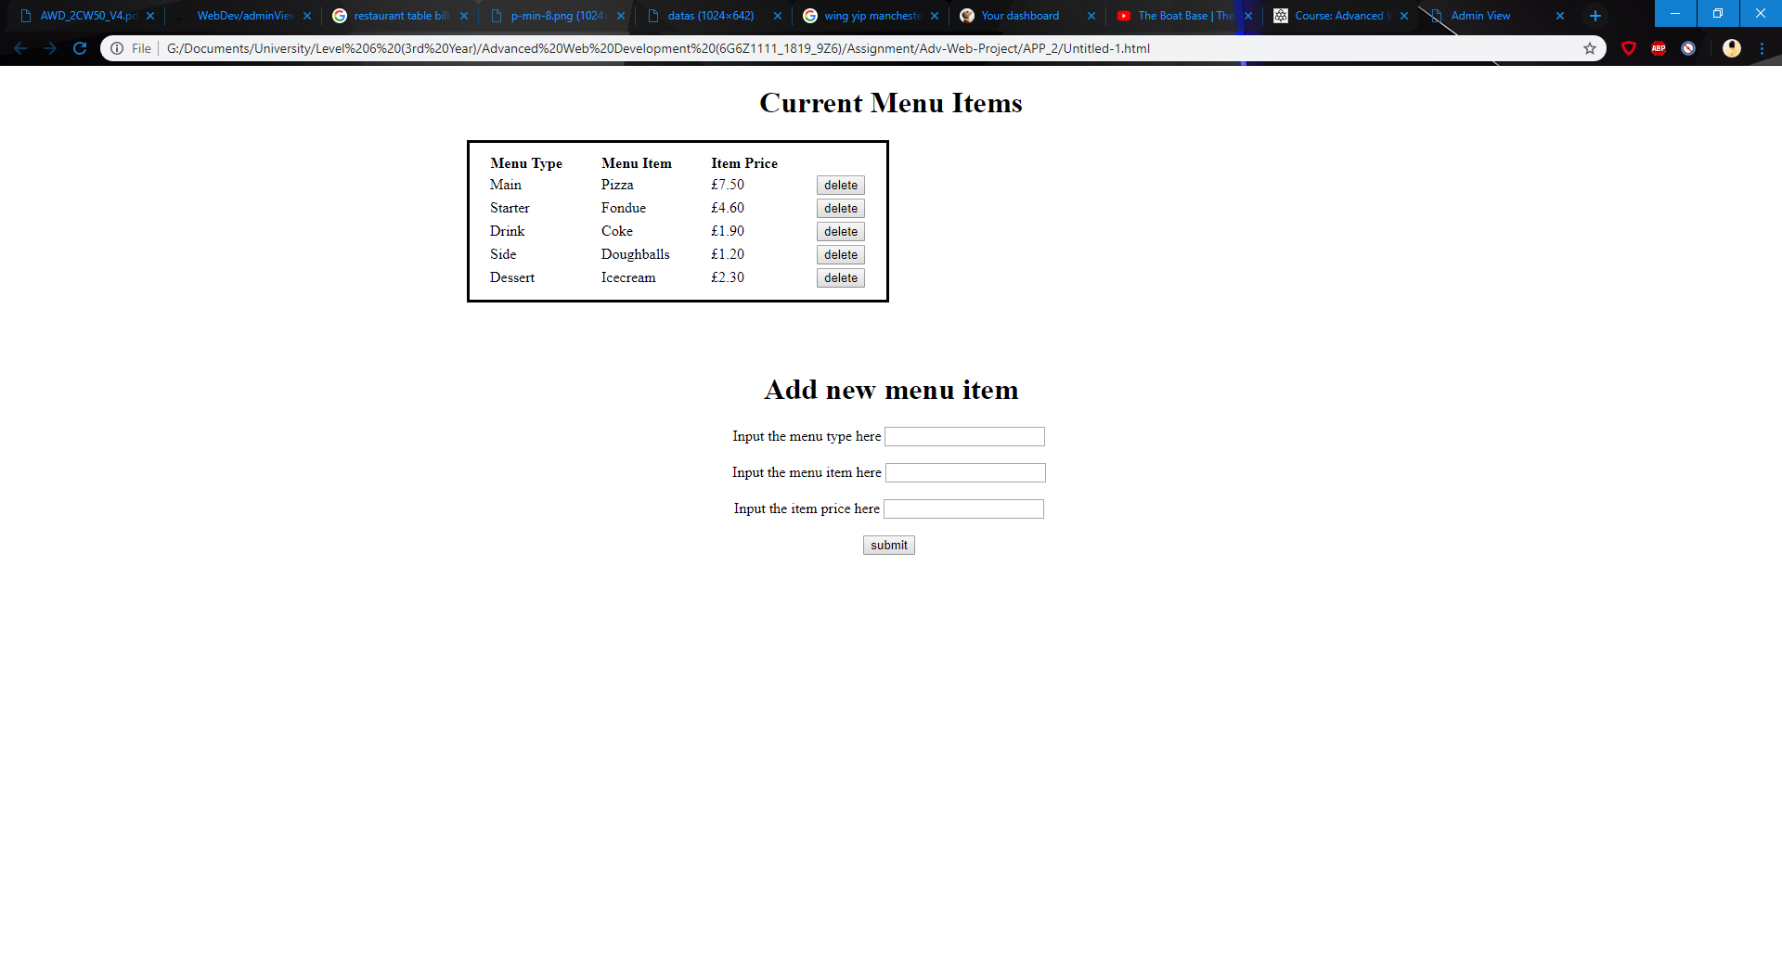
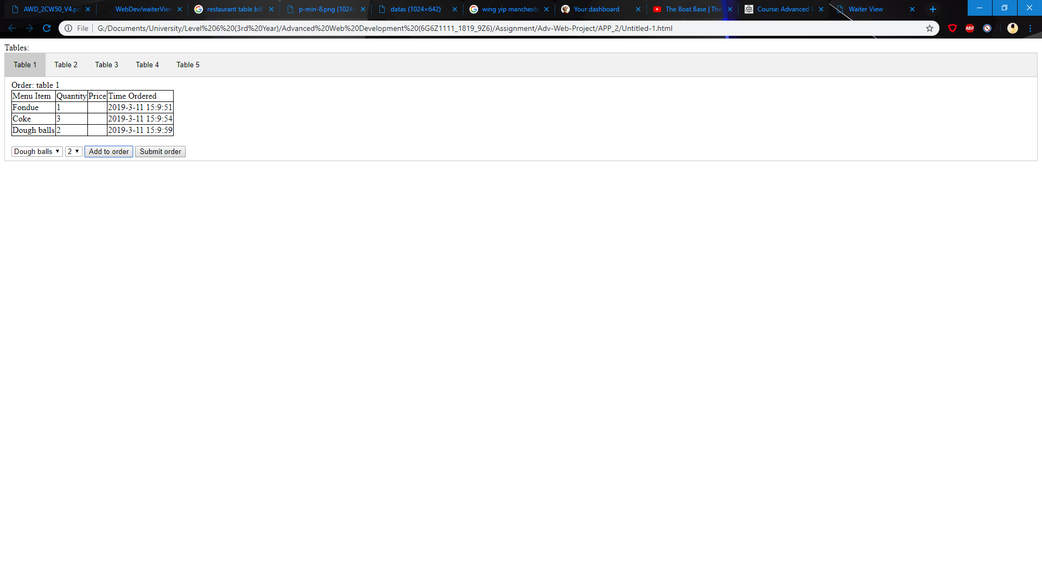
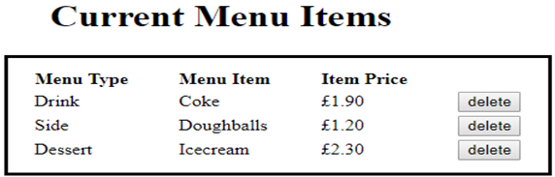
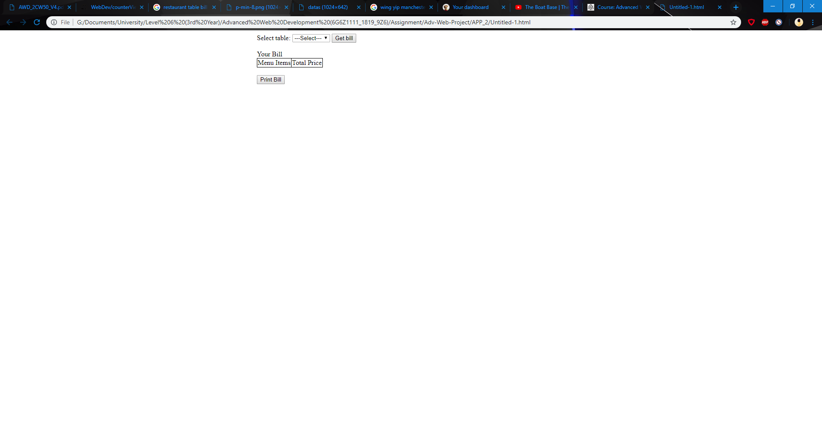
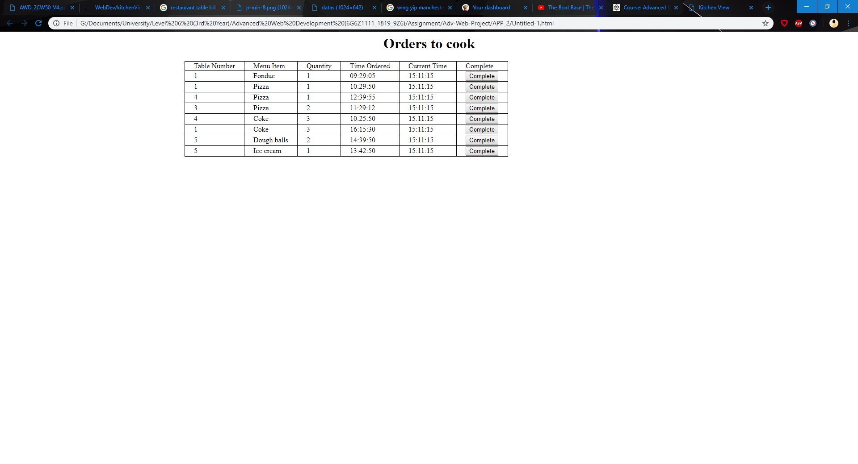

Alternatives
Front-end development
Used HTML, CSS, JavaScript
Waiter view used a tabbed pane idea to switch through the tables
Counter view featured a print preview for the bill (Preview Next Slide)
Admin view allowed adding and deleting items
Kitchen view allows completing cooked orders

Slide 12
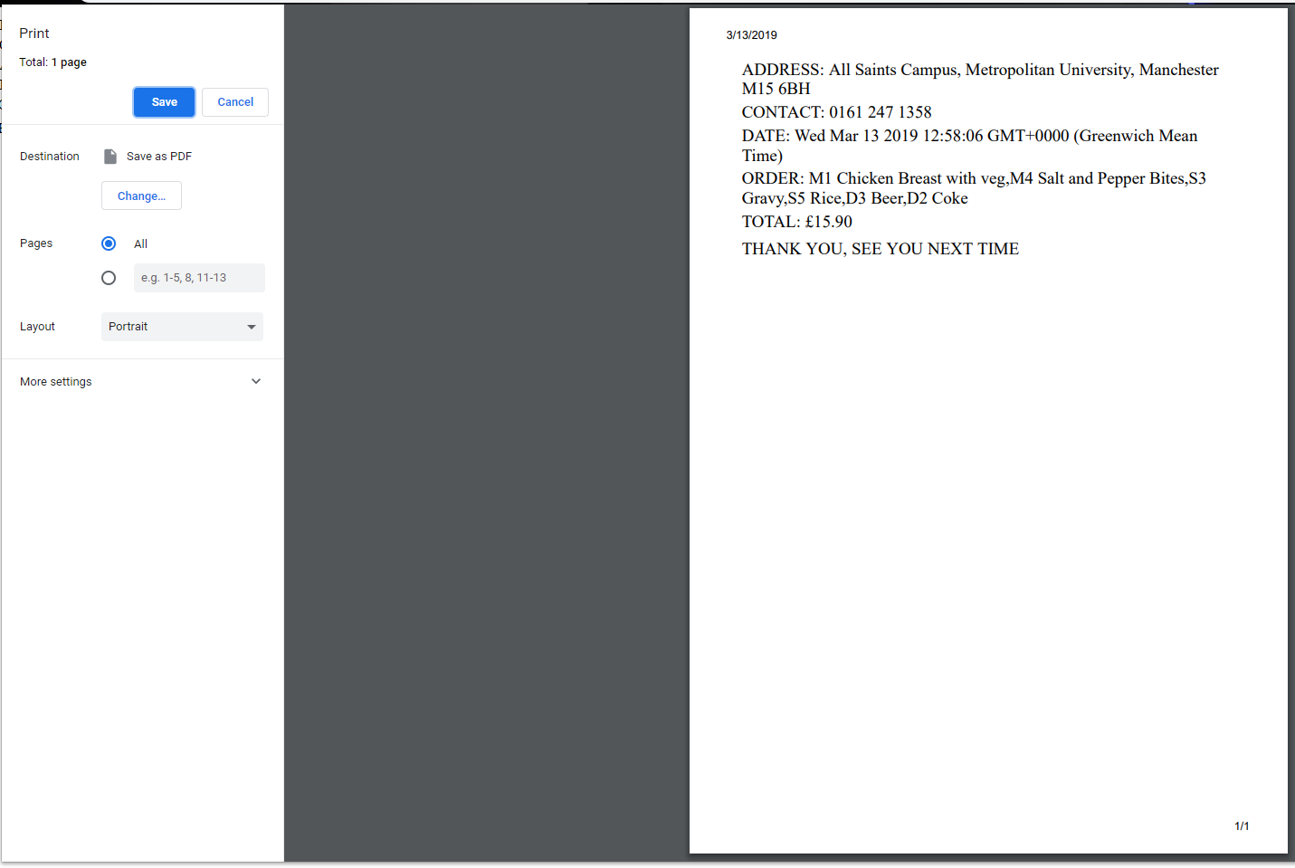
Extra
This is what happens when you press the ‘PRINT BILL’ button in the counter view, when you press the button you are taken to the page shown that lets you print out the bill with ease.

Slide 13
Thank you for listening! Any Questions?

